Slide 1
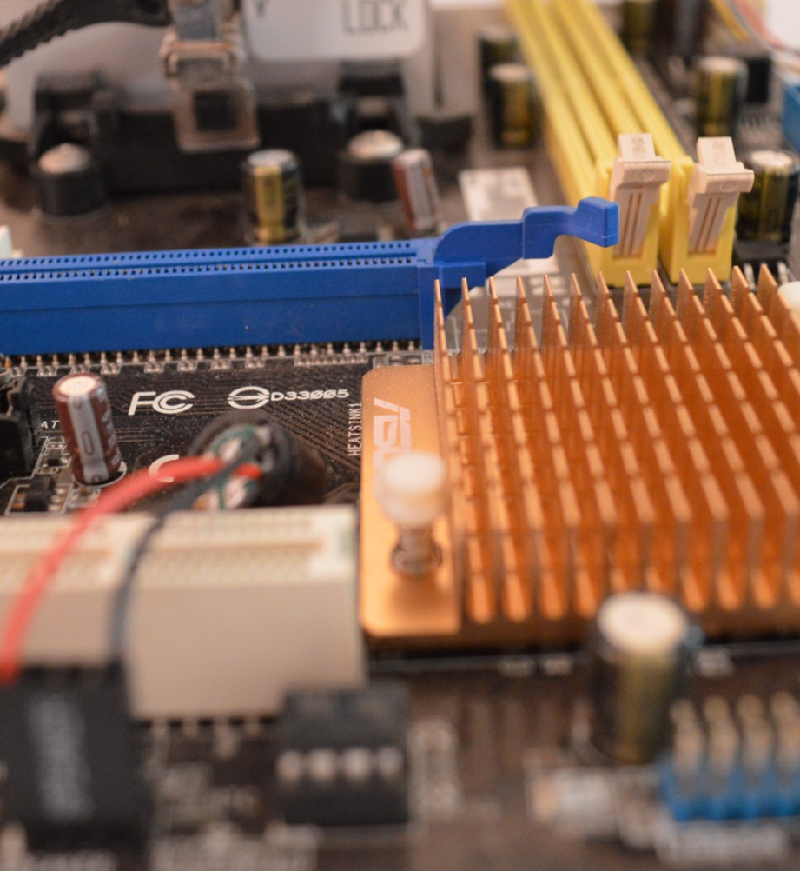
Computer Science
Transition workbook
The course is assessed by
2 exams (50% each exam)
The topic of Computer Science is at the heart of the modern world
Studying it can make you extremely sought after in todays job market
The transition from GCSE to A level is significant, this includes:
  An increased emphasis on technical content
  An increased emphasis independent research
This workbook is designed to allow you to practice some of these skills and build on your existing knowledge.
Task 1 is for me to understand your thinking.
Task 2 is for you gain some skills in independent learning.
Task 3 –6 Gain experience of content covered on the course
Please complete by your first lesson back in September.

Slide 2
1
“Tell me about yourself”
Why did you choose Computer Science?
Expected time to complete: ½ hour
In this simple task you get the opportunity to tell me your choices and reasons behind choosing to study Computer Science. Please answer all questions as best you can.
1. Why did you choose to study A level Computer Science?
2. What other courses have you chosen to study at Key Stage 5, and what made you choose this combination?
3. What are you hoping to achieve from studying Computer Science?
4. How would you describe yourself as a learner at GCSE? What skills where you good at, what areas would you like to improve on?
5. What are your other hobbies and interests outside of school? Anything related to Computing?

Slide 3
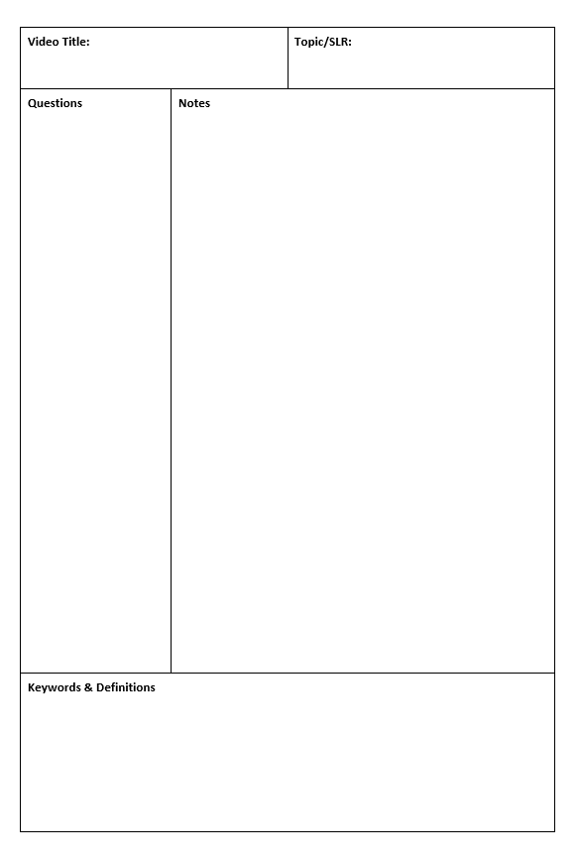
4
Note taking practice task
The Cornell method of note taking
Expected time to complete: 1½ hours
The expectation to do independent research at A Level will increase dramatically from GCSE.
There is a real skill to taking decent notes outside of lesson which are of value. Research has proven that one of the most effective methods is the “Cornell” note taking method.
To start download the “Cornell note taking template” from Craig n Dave:
  https://craigndave.org/cornell-note-taking/
Pick any two of the following videos from Craig ‘n’ Dave:
  OCR: https://student.craigndave.org/videos/ocr-alevel-slr01-alu-cu-registers-and-buses
  OCR: https://student.craigndave.org/videos/ocr-alevel-slr04-paging-segmentation-and-virtual-memory
  OCR: https://student.craigndave.org/videos/ocr-alevel-slr05-stages-of-compilation
  OCR: https://student.craigndave.org/videos/ocr-alevel-slr14-data-structures-part-2-graphs
Write the title of the video and its topic in the top boxes (use a different sheet for each video).
In the main “Notes” section, write notes from the video. You can do this in any way you like, a suggestion might be to rewind slightly when the canvas changes, thinking carefully about what was important in the previous few minutes.
Having recorded the notes, review them:
  Turn each part into a question in the section on the left.
  For example, the notes may say, “The value of the program counter is passed to the memory address register”.
  The question then becomes, “which register is the value of the program counter passed to?”
  Sometimes these questions are easy, and at times they are more difficult to write.
  There may also be more than one valid question.
  You will need to decide for yourself which are the most appropriate questions for revision.
Finally pull out all the key words and their definitions words the notes and list them in the bottom section.

Slide 4

8
Applying technical knowledge in context task
Augmented reality
Expected time to complete: 1½ hours
A key skill at A Level is being able to take a topic and then discuss it in the context of different scenarios.
Most theory-based exam questions will be asked in the form of a scenario, simply regurgitating what you know on the topic without contextualising your answer to the scenario will often result in low marks!
The topic for this exercise is “Augmented Reality”. It is a truly fascinating area of technology which has the potential to change almost every aspect of our daily lives.
Watch this brief video to learn more: https://www.youtube.com/watch?v=vQtwWzfzKXI
After watching the video complete the next slide which asks you to discuss the benefits, limitations and risks of augmented reality in the context of:
Medicine & health care
Gaming & entertainment
Schools & learning
Travel & tourism
Social media
Transport & navigation
Image by Oyundari Zorigtbaatar (20 March 2016) https://creativecommons.org/licenses/by-sa/4.0/legalcode

Slide 5
8
Applying technical knowledge in context task
Augmented reality
Expected time to complete: 1½ hours
Medicine & health care
Discuss the benefits, limitations and risks of augmented reality in this context:
Enter your answer here
Gaming & entertainment
Discuss the benefits, limitations and risks of augmented reality in this context:
Enter your answer here
Schools & learning
Discuss the benefits, limitations and risks of augmented reality in this context:
Enter your answer here
Travel & tourism
Social media
Transport & navigation
Enter your answer here
Discuss the benefits, limitations and risks of augmented reality in this context:
Discuss the benefits, limitations and risks of augmented reality in this context:
Enter your answer here
Discuss the benefits, limitations and risks of augmented reality in this context:
Enter your answer here

Slide 6


13
Systems software task
Operating systems
Expected time to complete: 2 hours
Operating systems are arguably the most important piece of software installed on a computer.
Carry out some research into the following areas:
The purpose of operating systems
The roles of operating systems
The purpose of interrupts
How interrupts work as part of the fetch-decode-execute cycle
Complete the tasks on the following slides.
Additional help:
For additional help and support in structuring your answer you might like to watch some of the videos from the following Craig ‘n’ Dave playlists:
OCR: SLR 4 – Operating systems – Systems software
https://student.craigndave.org/videos/slr-4-operating-systems-systems-software
AQA: SLR14 – Hardware & software
https://student.craigndave.org/videos/slr14-hardware-software

Slide 7
13
Systems software task
Operating systems
Expected time to complete: 2 hours
List at least 8 different roles an Operating System perform.
The purpose and roles of an Operating System
<Enter answer here>
<Enter answer here>
<Enter answer here>
<Enter answer here>
<Enter answer here>
<Enter answer here>
<Enter answer here>
<Enter answer here>

Slide 8
13
Systems software task
Operating systems
Expected time to complete: 2 hours
Rearrange the elements in the diagram below to show hoe the fetch-decode-execute cycle handles interrupts.
No
No
Fetch next instruction
Decode instruction
Execute instruction
Any higher priority interrupts to be processed?
Any higher priority interrupts to be processed?
Yes
Fetch next instruction
Decode instruction
Execute instruction
Yes
Pop registers off the memory stack
Put registers on the memory stack
Interrupt service routine loaded
When interrupt code complete

Slide 9
13
Systems software task
Operating systems
Expected time to complete: 2 hours
Drag the labels into their correct place on the following diagram:
Explain what this diagram is showing:
Hardware
User
Applications
Operating System

Slide 10
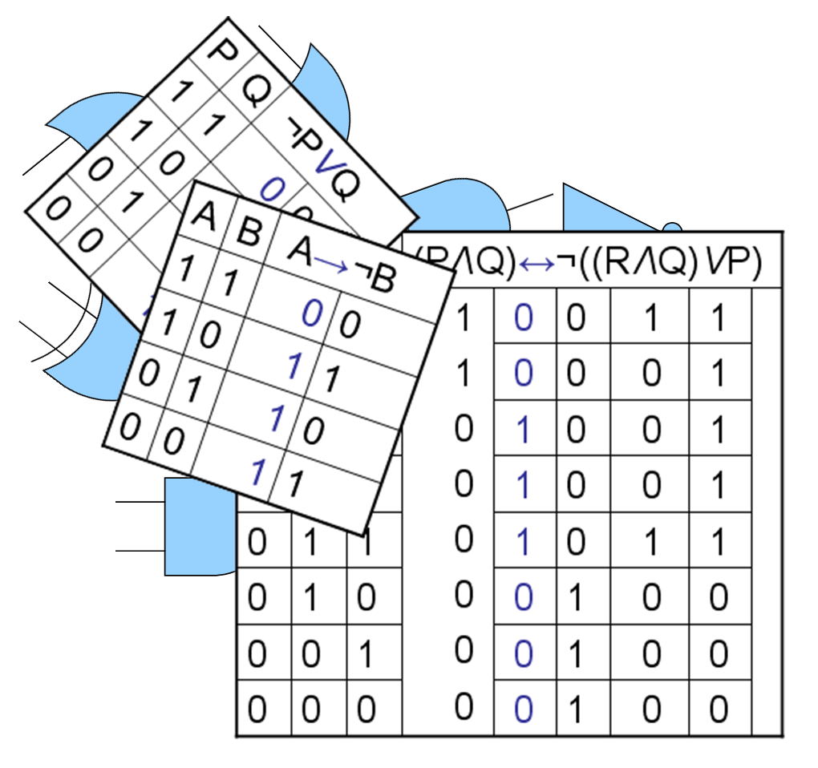
14
Computational logic task
Truth tables to circuit diagrams
Expected time to complete: 2 hours
An important area of computer science is understanding the logic gates and diagrams which are used to represent the physical circuitry of computer systems.
Carry out some research into the following areas:
Logic gates:
  AND
  NAND
  NOR
  NOT
  OR
  XOR
Truth tables
Boolean expressions
Circuit diagrams
Complete the tasks on the following slides.
Additional help:
For additional help and support in structuring your answer you might like to watch some of the videos from the following Craig ‘n’ Dave playlists:
OCR: SLR 15 – Boolean algebra
https://student.craigndave.org/videos/slr-15-boolean-algebra

Slide 11
14
Computational logic task
Truth tables to circuit diagrams
Expected time to complete: 2 hours
Drag the labels into their correct place on the following diagram:
OR
AND
XOR
NOT
NAND
NOR

Slide 12
14
Computational logic task
Truth tables to circuit diagrams
Expected time to complete: 2 hours
Draw the circuit diagram which would represent the following Boolean expression:
OCR Boolean Expression: F = ¬(¬C ∧ (A V B)
Complete the truth table for the circuit diagram you have drawn
A | B | C | D | E | F
0 | 0 | 0
0 | 0 | 1
0 | 1 | 0
0 | 1 | 1
1 | 0 | 0
1 | 0 | 1
1 | 1 | 0
1 | 1 | 1
A
B
F
C

Slide 13

17
Linear search programming task
Algorithms: from theory to practice
Expected time to complete: 4 hours
A core concept of computer science is that of data structures and algorithms.
It is also an area which many students struggle with during examinations.
Probably the most basic algorithm is that of the “linear search”.
If you have done the GCSE course you will have learnt about this searching algorithm already.
Start by learning or refreshing your knowledge of the linear search algorithm by using the videos on this page:
https://www.craigndave.org/algorithms-linear-search
Once you are happy with the theory complete the exercises on the following slides.

Slide 14
17
Linear search programming task
Algorithms: from theory to practice
Expected time to complete: 2 hours
Describe what the linear search algorithm does.
What are the applications of the linear search algorithm?
Write out the steps of the linear search algorithm in simple-structured English.
Draw a simple diagram which illustrates the linear search algorithm.

Slide 15
17
Linear search programming task
Algorithms: from theory to practice
Expected time to complete: 2 hours
Write out pseudocode for the linear search algorithm.
The algorithm should use an array called items which is pre-populated with the following values: "Florida","Georgia","Delaware","Alabama","California“
The algorithm should ask the user to “Enter the state to find:”
If the algorithm locates the state entered by the user in the array it should report back to the screen “Item found at position n”
If the algorithms can not locate the state entered by the user in the array it should report back to the screen “Item not found”

Slide 16
17
Linear search programming task
Algorithms: from theory to practice
Expected time to complete: 2 hours
Have a go at coding the linear searching algorithm in a programming language of your choice.
The program should work use an array called items which is pre-populated with the following values: "Florida","Georgia","Delaware","Alabama","California“
The program should ask the user to “Enter the state to find:”
If the program locates the state entered by the user in the array it should report back to the screen “Item found at position n”
If the program can not locate the state entered by the user in the array it should report back to the screen “Item not found”
Cut and paste the code you have written into the box below:

