Slide 1
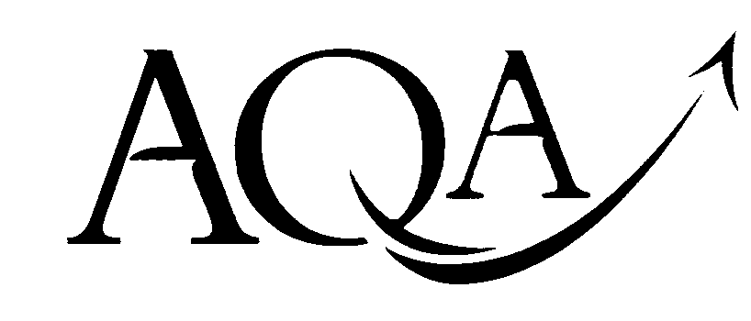
Area of Study 01: Rhythm and Metre

Slide 2
Areas of Study
Rhythm and Metre
: Harmony and Tonality
Texture and Melody
Dynamics and Timbre
Structure and Form

Slide 3
Rhythm and Metre
This is all about beats, timing and sound patterns
Metre – This is a regular pattern of beats in every bar, indicated by a time signature
Rhythm – is the way different lengths of sound are combined to produce patterns in time.

Slide 4
Pulse
The pulse is the beat of the music. It is what you tap your feet to.
Although the music may have rhythms made up of different lengths of notes, the pulse or beat will be steady.
Track 01
Listen to the start of this track
Tap the pulse
Can you describe what other ‘rhythms’ are present around the pulse?

Slide 5
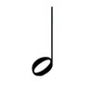
Rhythm - Back to Basics
= 4 beats
= 1 beat
Semibreve
Crotchet
= 2 beats
= ½ beat
or
Minim
Quaver
2 Quavers

Slide 6
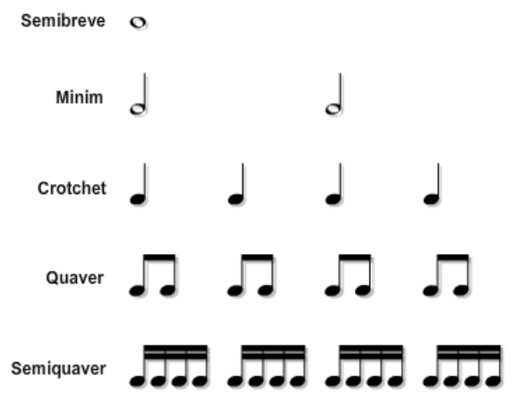

Slide 7
Time Signatures cont.
4 x
Beats every bar
Main beat of the bar

Slide 8
Simple Time
2 types of Time Signature
Examples of Simple Time Signatures are;
2
4
3
4
4
4

Slide 9
Compound Time
2 types of Time Signature
Compound time signature have 6, 9 or 12 as their top number
6/8 Time signature has a feeling of 2 & 3
Music in these time signatures feel as though they have a main beat, which divide into 3.
Main Beat
Main Beat
Main Beat
Main Beat
Main Beat

Slide 10
Regular and Irregular
Regular Time Signatures are when the beats in a bar can be grouped e.g.
2/4, 6/8 (2 beats per bar) DUPLE
3/4, 9/8 (3 beats per bar) TRIPLE
4/4, 12/8 (4 beats per bar) QUADRUPLE
Irregular Time Signatures are when the beats can not be grouped as above
e.g 5/4 – 5 beats in a bar would have to be grouped as a 2 and 3.
Track 02
Listen to the Example:
The Time Signature is 5/4. It sounds like there is one group of 3 then one group of 2 (irregular)

Slide 11
Cross-Rhythms
Track 04
Rhythmic Device
These are when two different rhythms are played together at the same time.
Usually conflicting against each other
Common in African Music

Slide 12
Polyrhythms
Rhythmic Device
When two or more rhythms are played at the same time.
The rhythms may have accents in different places, but still feel as though they fit together.
Lots of African music is polyrhythmic
Look at the example on the next slide.

Slide 13
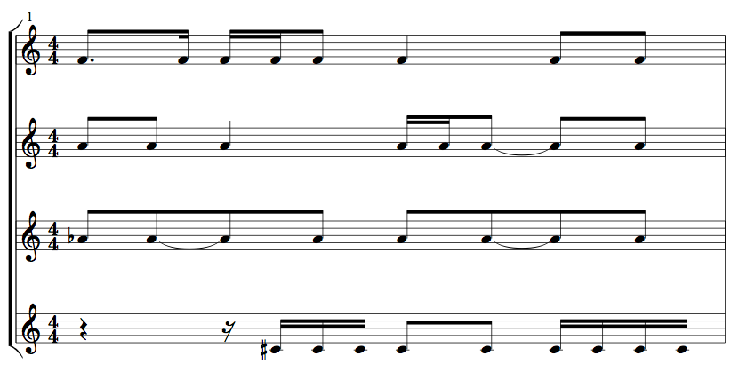
Polyrhythms
Track 05
Rhythmic Device

Slide 14
Tempo
Tempo simply refers to the speed of the music
It can measured in 'beats per minute’ (bpm)
E.g.
Tempo: = 120
The speed can also be indicated by an Italian word
120 crotchet beats every minute

Slide 15
Tempo – Italian words
Presto = Very fast
Vivace = Fast and lively
Allegro = Fast, quickly and bright
Moderato = Moderately
Andante = Walking pace
Adagio = Slow
Largo = Very Slow
Accellerando = Getting faster
Ritardando= Getting slower

Slide 16
Rubato
If this is written in the music, the performer is able to make changes to the tempo.
In response to the way the music makes them feel, the performer may want to slow down or speed up.
It indicates there is no strict tempo

Slide 17
Drum fills
Drum fills are normally used to build the music up, or to change between sections i.e. verse, chorus etc
Mostly found in Popular music, like Rock, pop, Jazz etc.
Notice how a drum fill is used to open this pop song.
Drum fills are used to connect different sections too.
Track 06
Beatles – “She Loves You”

